Slide 1
EESI data analysis pipeline
From Tofware output to time series (e.g. for PMF)
General Overview of Jungfraujoch EESI dataset
Julian Weng
2025/03

Slide 2
Input

Slide 3
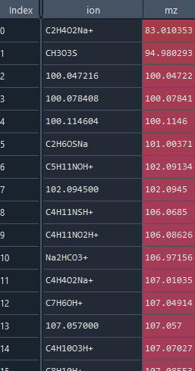
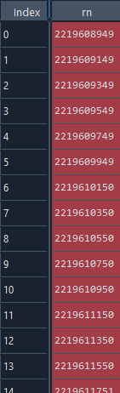
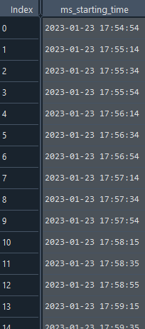
Input
Amus: Ion names & m/z
Run number series of EESI data
Time series of EESI data
Same dimension

Slide 4
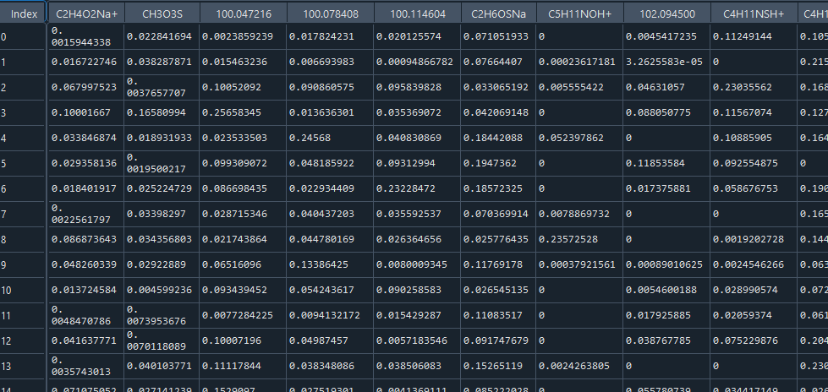
Input
Ions
EESI data matrix
Run numbers / time stamps

Slide 5
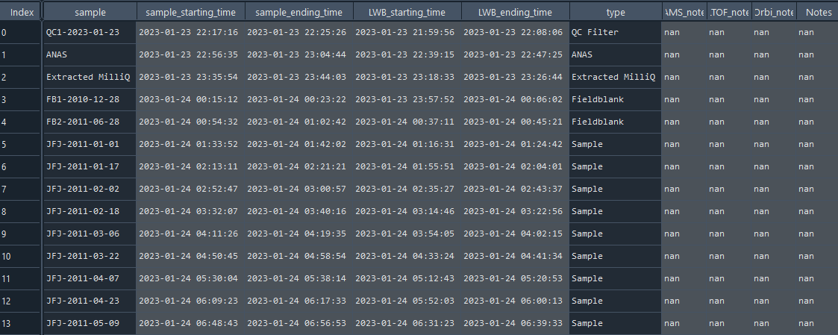
Input
Autosampler dataframe
(sample IDs and types, sample & waterblank starting/ending times)

Slide 6
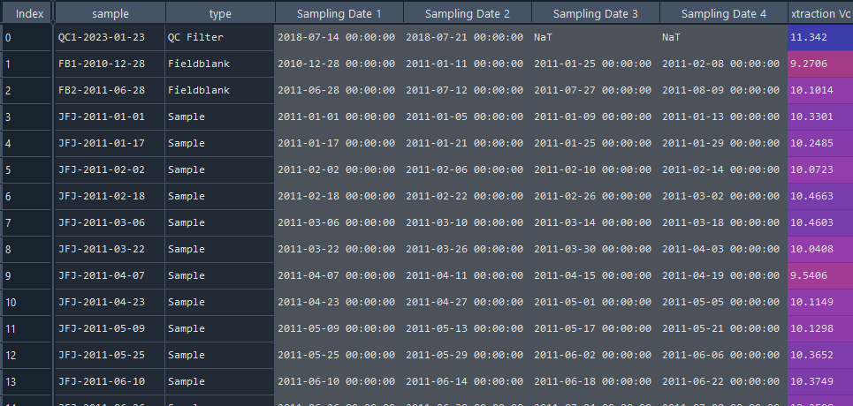
Input
Sample info data
(Sampling dates, effective extraction volumes)

Slide 7
Pre-processing and filtering

Slide 8
Removing larges spikes/outliers
Based on primary ion signal

Slide 9
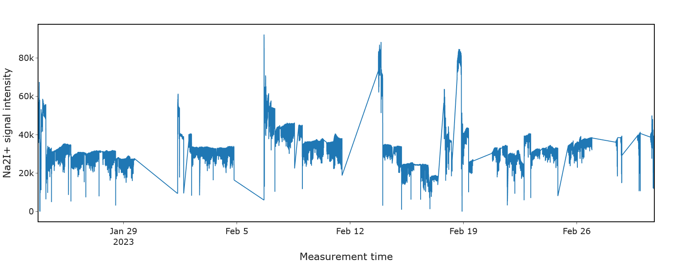
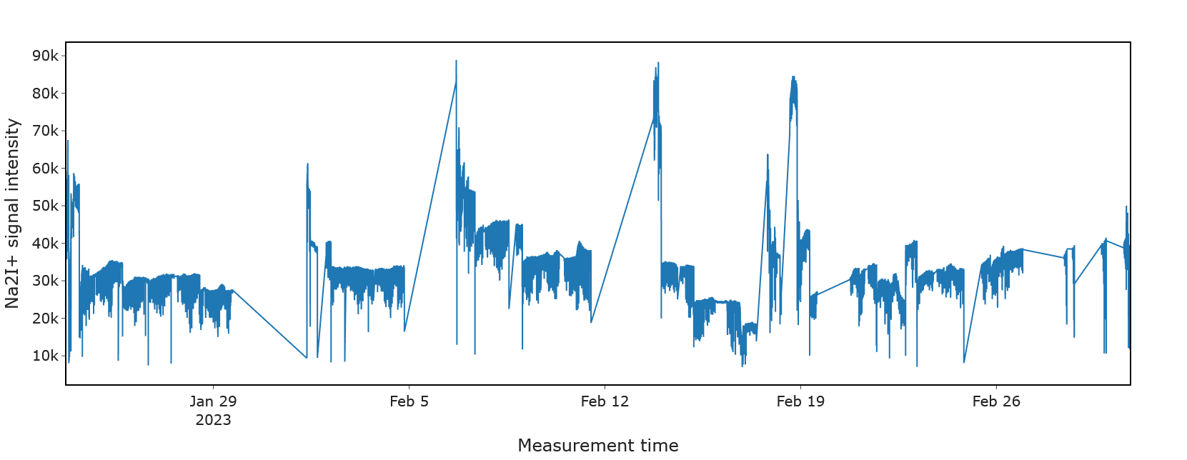
Removing spikes
Before
Define cutoffs (low & high) based on visual inspection of primary ion signal; make sure no real data points out of defined cutoffs Simply filter values out of cutoff range
Could be improved by more local filtering…but later steps also include filters
After
filtered
Filtering is not very harsh (only big spikes removed)

Slide 10
Assignment of run numbers to samples and waterblanks

Slide 11
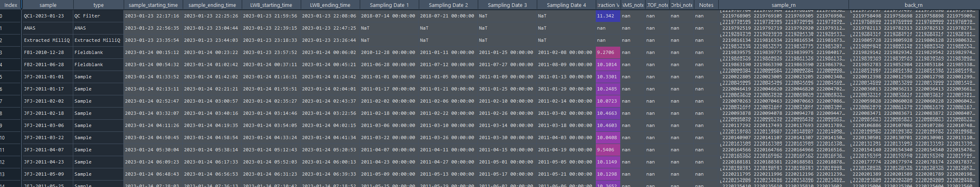
Assign RN to each sample and its corresponding waterblank
Using time information of autosampler df (EESI data needs to have same time, check for shifts due to time lags in computers)
…

Slide 12
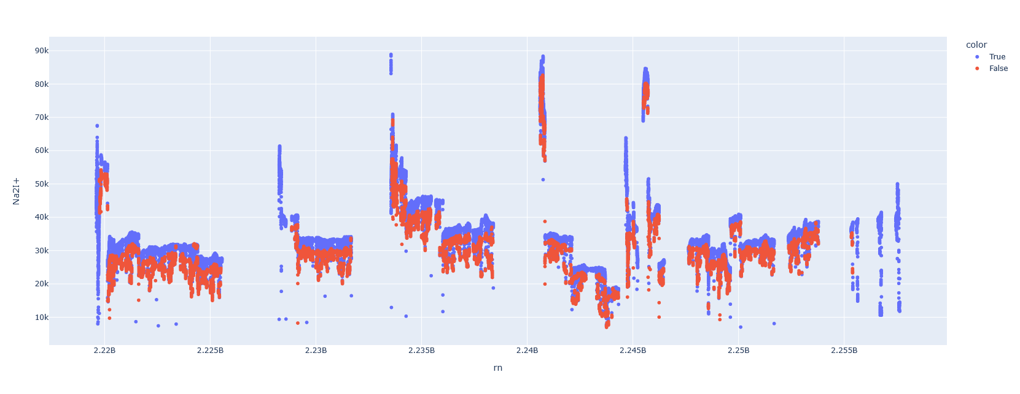
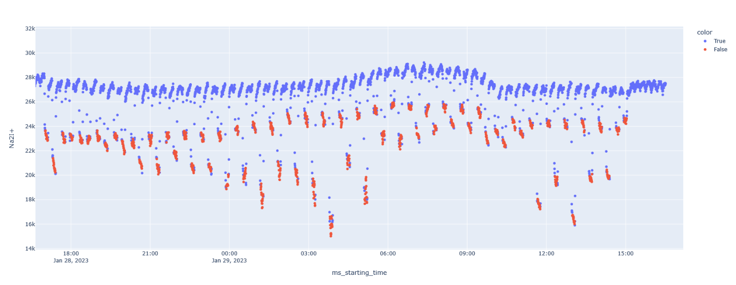
Assign RN to each sample and its corresponding waterblank
wb
sample

Slide 13
For datapoints of each sample and wb:
Filtering of outlier datapoints based on median absolute deviation filter
(and excluding RN that only contain nan)

Slide 14
median absolute deviation filter
Compute median of differences of each RN i to its sample median
Then for each RN, if difference / median(differences of all RN of this sample) lays above threshold => filter as outlier
Thresholds applied:
Sample: 2
Water Blanks: 3
Filtering should be done based on ion present in all samples! Primary ion or internal standard, not levoglucosan (as this is just random noise in some samples and all wb)

Slide 15
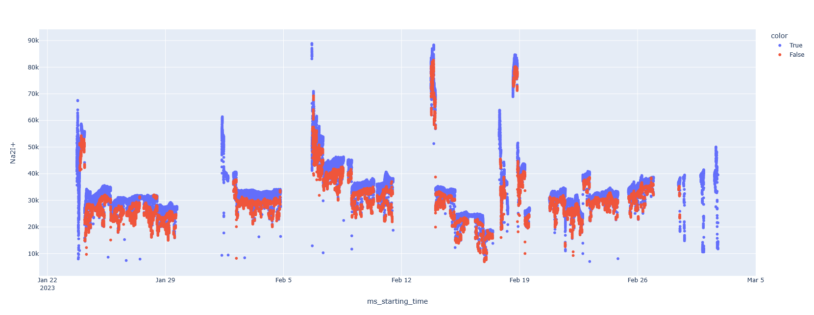
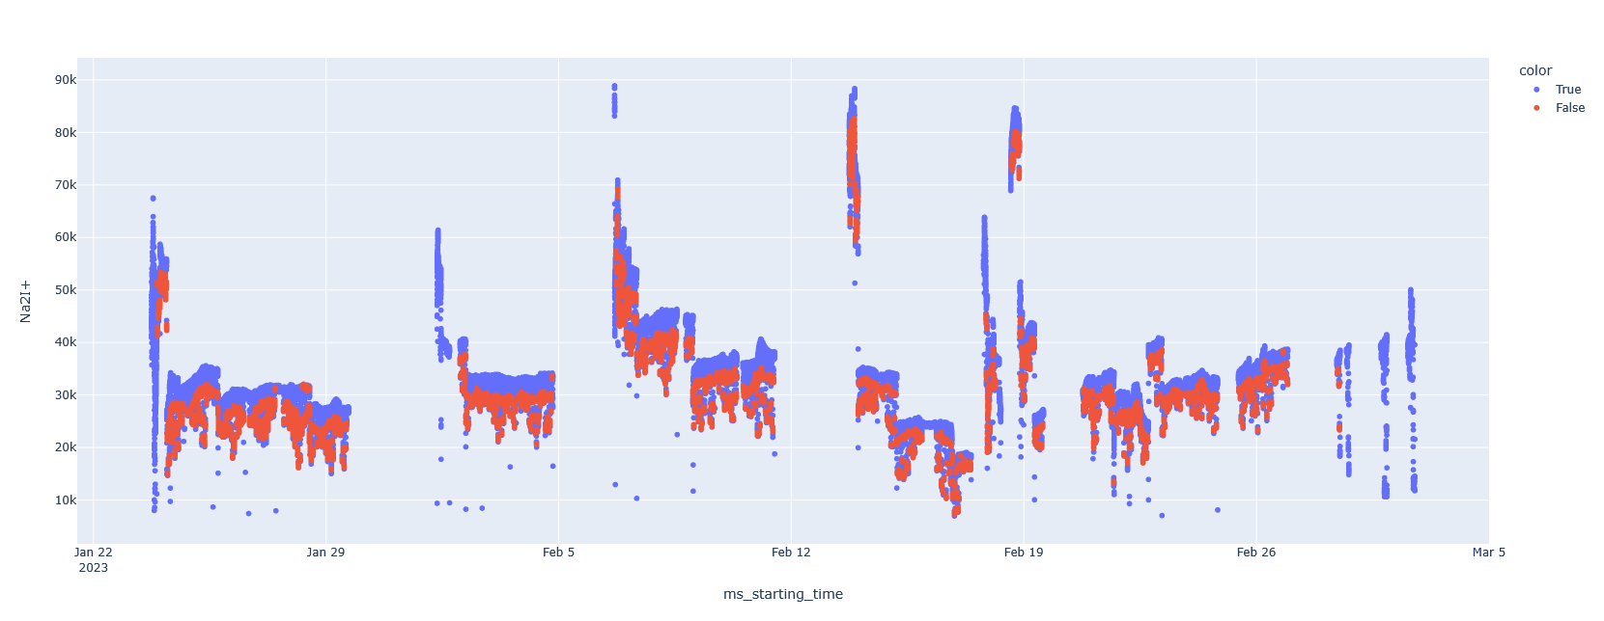
median absolute deviation filter performance
filtered
Before
After

Slide 16
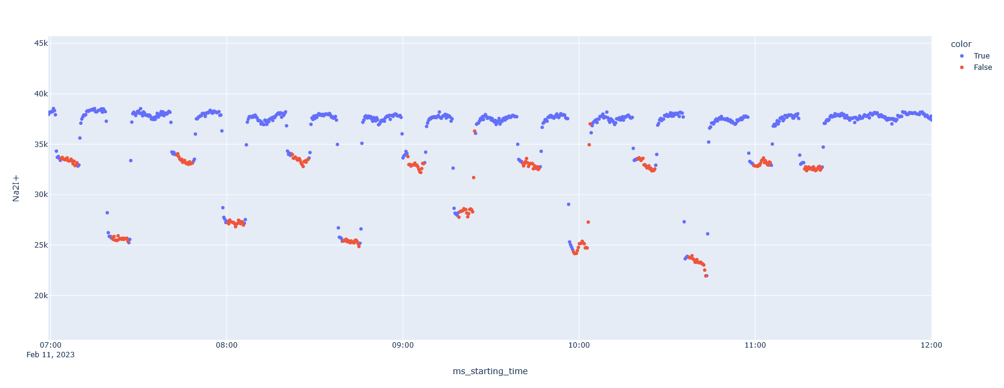
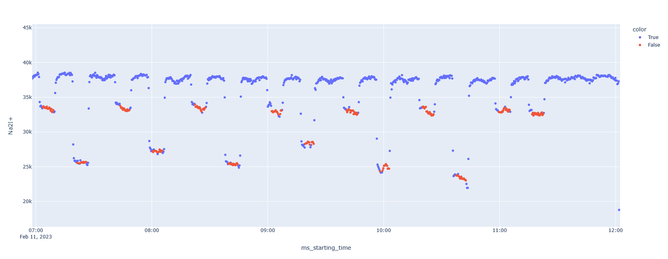
median absolute deviation filter performance
filtered
Before
After

Slide 17
Normalizations

Slide 18
The logic behind normalization
Signal in EESI proportional to molar concentration of species in aerosol (in contrast to AMS)
Sensitivity (signal response per molecule in aerosol) species dependent
Therefore, no quantification of ‘unspiked’ species with internal standard (in contrast to AMS)
Side note: Previously workflows, used to do it anyway as a very rough approximation, respecting the differences in molecular masses, including Na⁺, etc. <=> part of semi-quantification (now: quantification attempted by comparison of PMF factor output of quantitative AMS vs EESI)

Slide 19
The logic behind normalization
What (apart from chemical structure) affects the relation ‘molar conc. in extract’ vs ‘signal in EESI’?
Inconsistent performance of the nebulization process
EESI spray fluctuations (spray position etc.)
Other inconsistencies in EESI performance?
Assumption for all effects: same behavior for all species with respect to these changes
Correct with
Primary ions aka reagent ions => Reflects EESI fluctuations
Internal standard => Reflects EESI & Nebulization fluctuations

Slide 20
Normalization – Overview of current procedure
i) Point by point normalization (i.e. before averaging) with reagent ions (Na2I+ and Na2I+ (H2O))
=> for checking and evaluating internal standard performance throughout the measurements
ii) Point by point normalization (i.e. before averaging) with internal standard ions => That means primary ion normalized ions are getting normalized by primary ion normalized internal standards

Slide 21
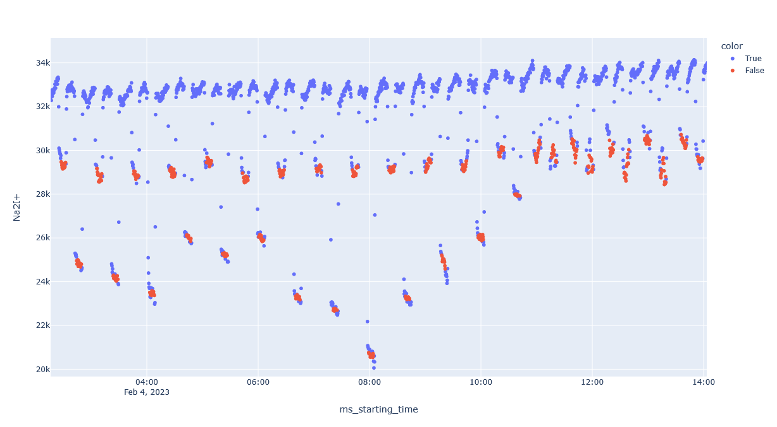
Waterblank – Sample Patterns: Primary ion
wb
sample
Samples with higher concentration => stronger primary ion depletion

Slide 22
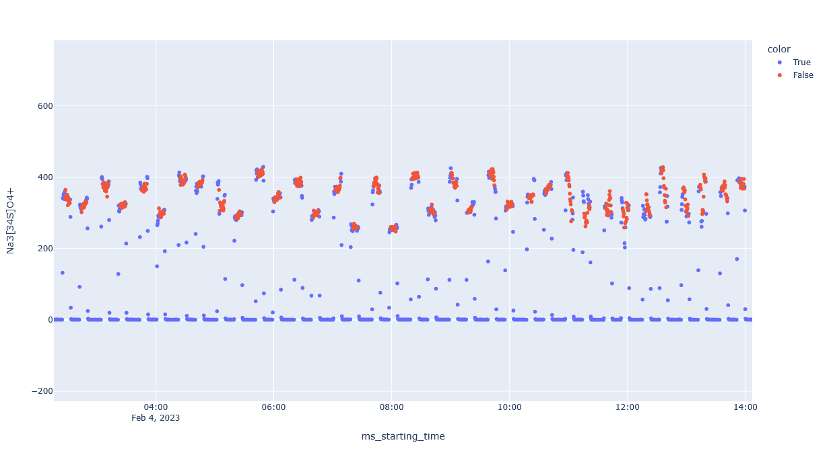
Waterblank – Sample Patterns: Internal standard sulfate
wb
sample
Note: trends in good agreement with nitrate internal standard
Expected under ideal conditions: similar levels for both, wb and sample
Expected under real conditions: higher levels for high concentration samples (as more internal standard brought to aerosol phase; at least that’s observation in AMS)
Observed: wb higher than samples, seems to scale with sample concentration => competition for reagent ion (reagent ion depletion?

Slide 23
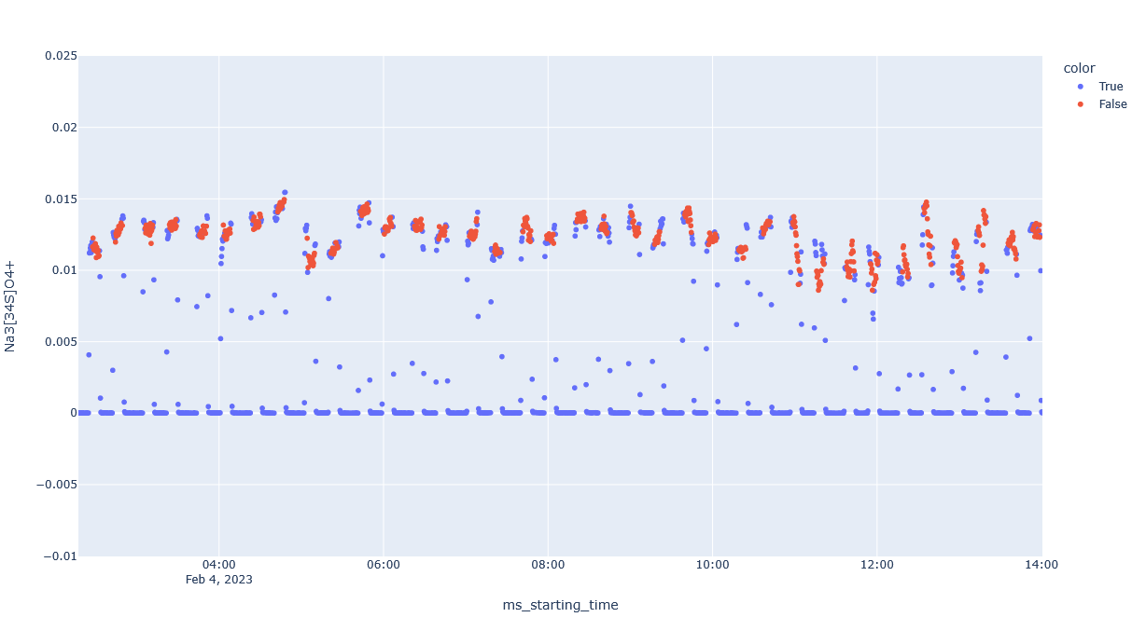
Waterblank – Sample Patterns: Internal standard sulfate (primary ion normalized)
wb
sample
Observation: wb and samples aligned closer
Primary ion is more depleted in high concentration samples, at same time lower internal standard intensity in high concentration samples (maybe due to more competition for primary ion) => these two effects compensate when doing the normalization

Slide 24
Normalization by primary ions (reagent ions)

Slide 25
Overview of primary ions (within the fit range currently applied)
Ion | Comment | Fit as (name in peak list) | m/z
Na2I+ |  | Na2I+ | 172.88347
Na3I2+ |  | I2Na3+ | 322.77771
Water clusters
Ion | Comment | Fit as (name in peak list) | m/z
Na2I(H2O)+ | Water cluster | Na2I(H2O)+ | 190.89403
Na3I2(H2O)+ | Water cluster | H2I2Na3O+ | 340.78827

Slide 26
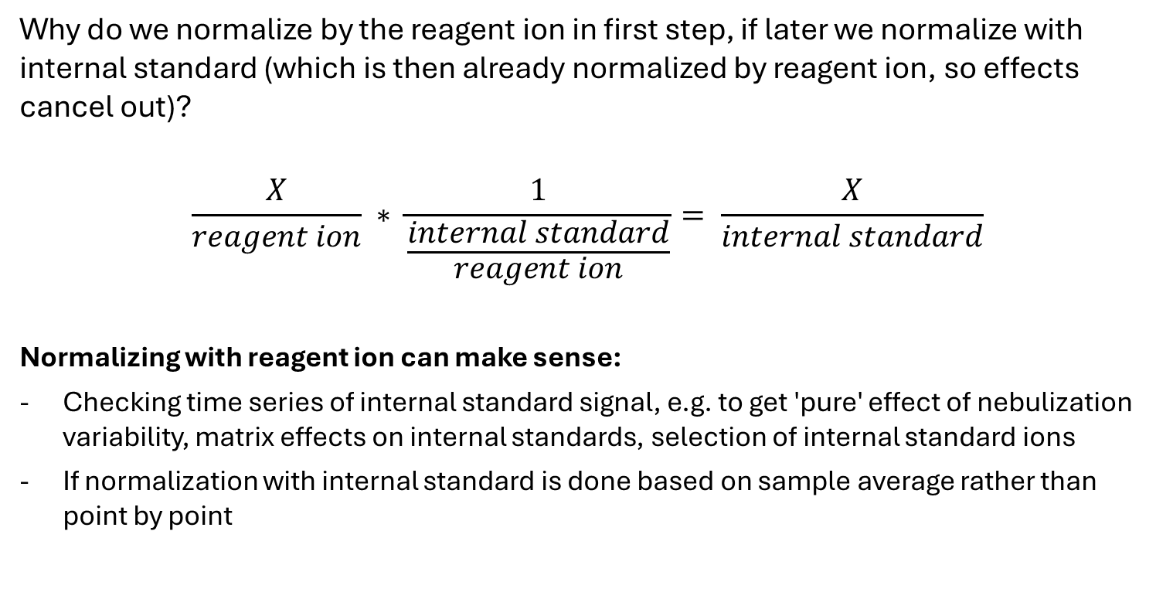
Why?
Why do we normalize by the reagent ion in first step, if later we normalize with internal standard (which is then already normalized by reagent ion, so effects cancel out)?
$$\frac{X}{reagent ion} ∗ \frac{1}{\frac{internal standard}{reagent ion}}= \frac{X}{internal standard}$$
Normalizing with reagent ion can make sense:
Checking time series of internal standard signal, e.g. to get 'pure' effect of nebulization variability, matrix effects on internal standards, selection of internal standard ions
If normalization with internal standard is done based on sample average rather than point by point

Slide 27
Considerations for normalizing by primary ions
Primary ion signal reflects EESI fluctuations
But: signal intensity also reflects on sample concentration, as reaction with sample ions leads to primary ion signal depletion
=> Normalization by primary ion introduces a bias with respect to sample concentration

Slide 28

Normalization by primary ions
For each run number and ion j:
$$I_{j,norm}= \frac{I_{j }}{I_{\left(Na2I+\right)}+I_{(Na2I(H2O)+)}}$$
Sum of primary ion and its water cluster

Slide 29
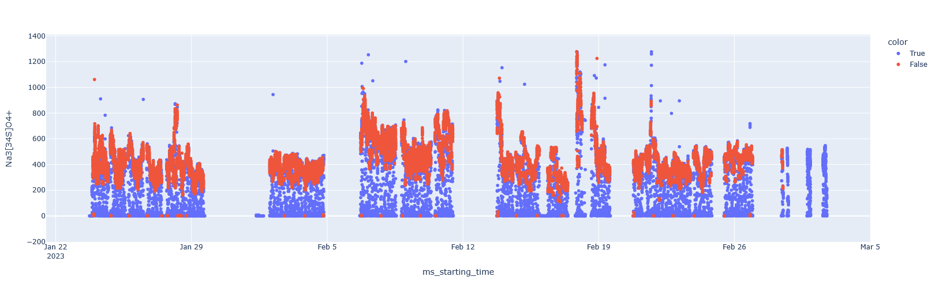
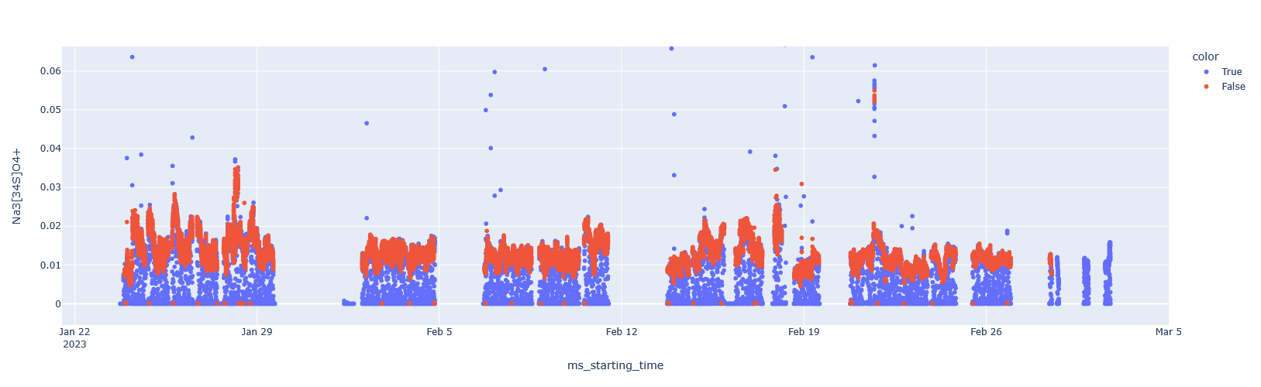
Sulfate internal standard – before and after normalization with primary ion
Before
After

Slide 30
Normalization by internal standards

Slide 31
Overview of sulfate internal standard ions
Ion | Comment | Fit as (name in peak list) | m/z
Na3[34S]O4+ | Considered important | Na3[34S]O4+ | 165.92
Na3[34S]O4(NaI)+ | Considered important | INa4[34S]O4+ | 315.82
Water clusters
Ion | Comment | Fit as (name in peak list) | m/z
Na3[34S]O4(H2O)+ | Considered minor | Na3[34S]O4(H2O)+ | 183.93
Na3[34S]O4(NaI)(H2O)+ | Considered minor | H2INa4O5[34S]+ | 333.83

Slide 32
Overview of nitrate internal standard ions
Ion | Comment | Fit as (name in peak list) | m/z
Na2[15N]O3+ | Considered important | Na2[15N]O3+ | 108.96
Na2[15N]O3(NaI)+ | Considered important | INa3[15N]O3+ | 258.86
Water clusters
Ion | Comment | Fit as (name in peak list) | m/z
Na2[15N]O3(H2O)+ | Considered minor | - | 126.97
Na2[15N]O3(NaI)(H2O)+ | Considered minor | - | 276.86

Slide 33
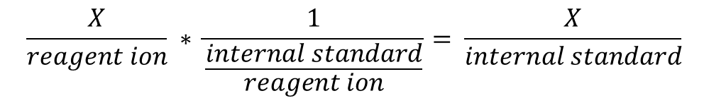
Considerations for normalizing by internal standards
Primary ion normalized ions are getting normalized by primary ion normalized internal standards
=> Primary ion normalization effect cancels out
$$\frac{X}{reagent ion} ∗ \frac{1}{\frac{internal standard}{reagent ion}}= \frac{X}{internal standard}$$

Slide 34
Averaging Effective extraction volume correction
Water blank subtraction

Slide 35
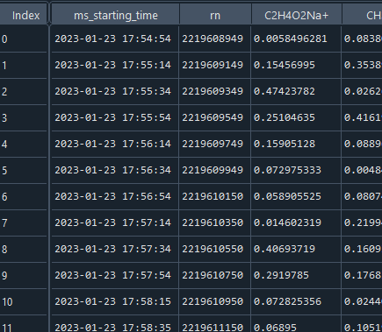
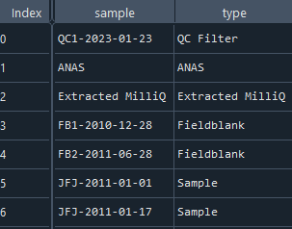
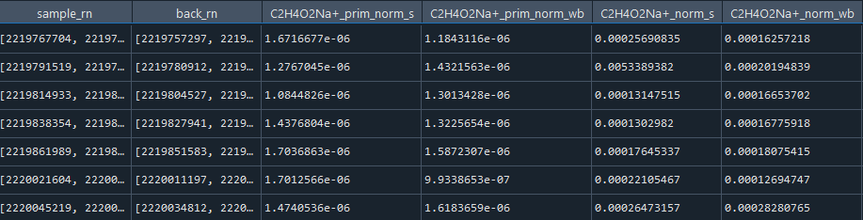
Averaging
Normalized EESI data
For each sample and its corresponding waterblank:
Compute average of normalized data (using assigned RN for each sample and its wb)
Primary ion normalized
Internal standard normalized
…
Autosampler dataframe with different averages for s:sample and wb: waterblank

Slide 36
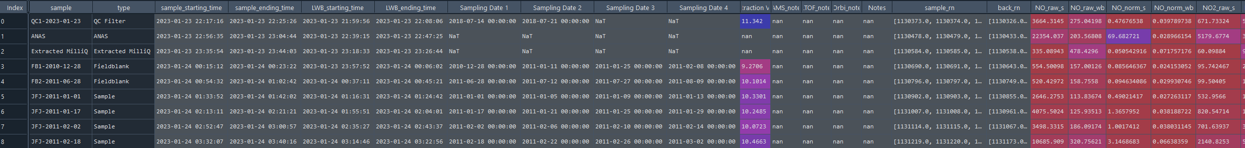
Effective extraction volume correction – Background
Problem: for samples where filters were extracted, effective spiking volume does not equal the theoretical one, as some volume is held back in vials, syringes and filter punches
=> Internal standard concentration effectively changed (higher than expected)
Corrected for by weighing vials before (empty) and after extraction and applying a correction factor
Theoretical for JFJ campaign: 12 mL
…
Experience from JFJ: 10-25 % deviation

Slide 37
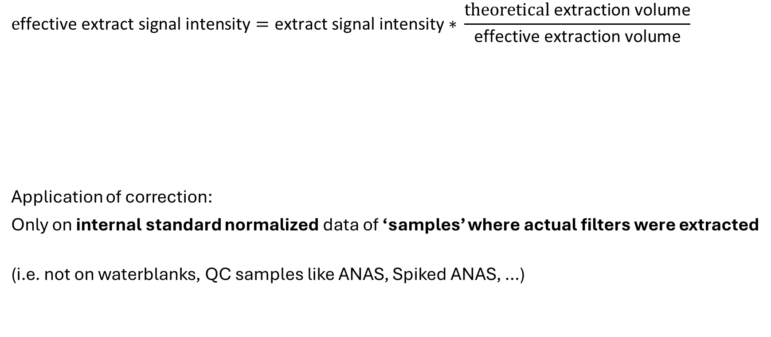
Effective extraction volume correction – Formula
$$\text{e}\text{ffective} \text{extract} \text{signal} \text{intensity}=\text{extract} \text{signal} \text{intensity}\text{ ∗ }\frac{\text{theoretical} \text{extraction} \text{volume}}{\text{effective} \text{extraction} \text{volume}}$$
Application of correction:
Only on internal standard normalized data of ‘samples’ where actual filters were extracted
(i.e. not on waterblanks, QC samples like ANAS, Spiked ANAS, …)
Correction factor, >1

Slide 38
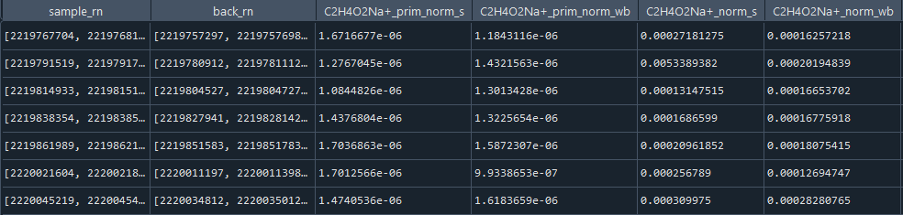
Effective extraction volume correction – Example
Primary ion normalized
Internal standard normalized
Before
…
Primary ion normalized
Internal standard normalized
After
…

Slide 39
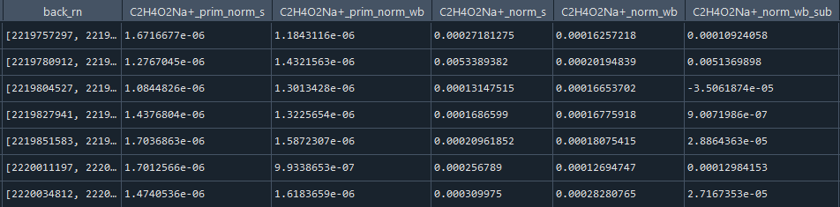
Waterblank subtraction
For internal standard normalized data, for each ion subtract sample average (effective volume corrected) with it’s corresponding wb average
sample – wb = waterblank subtracted sample
Primary ion normalized
Internal standard normalized
…

Slide 40
'Semi-Quantification’
= Scaling to ambient conditions

Slide 41
'Semi-Quantification’ = Scaling to ambient conditions – The concept
'Semi-Quantification’ was performed by previous workflows and partly taken over here
Goals of 'Semi-Quantification’:
Make relative ion intensities comparable between samples that were treated differently in sampling or sample preparation
Accounted for: sampling rate and time, punch size, number of punches, extraction volume
For JFJ samples: number of punches was different for some sample batches; rest of the parameters are consistent
Currently not implemented (used to be applied by some previous workflows):
Attempting to quantify single ion species to approximate ambient concentrations; this goes under the assumption that sensitivities of internal standard and all other ion species is comparable (which is not the case); for ambient mass concentrations, molar mass of each species needs to be known (not possible for unspecified formulas)

Slide 42
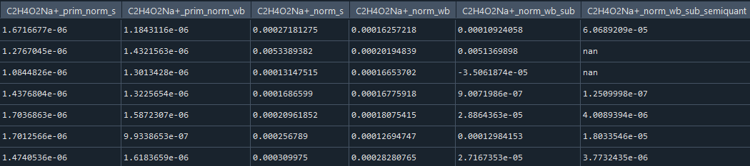

'Semi-Quantification’ = Scaling to ambient conditions
$$I_{semi−quantified}=\frac{I_{extract−quantified}∗extraction volume \left[mL\right]}{percent of filter area extracted}∗\frac{1}{sampled air volume [m3]}$$
$$sampling time∗sampling rate$$
$$\frac{punch area∗\# of punches}{effective filter area}$$
only for samples that were actually extracted
…

